Slide 1
CEC

Slide 4
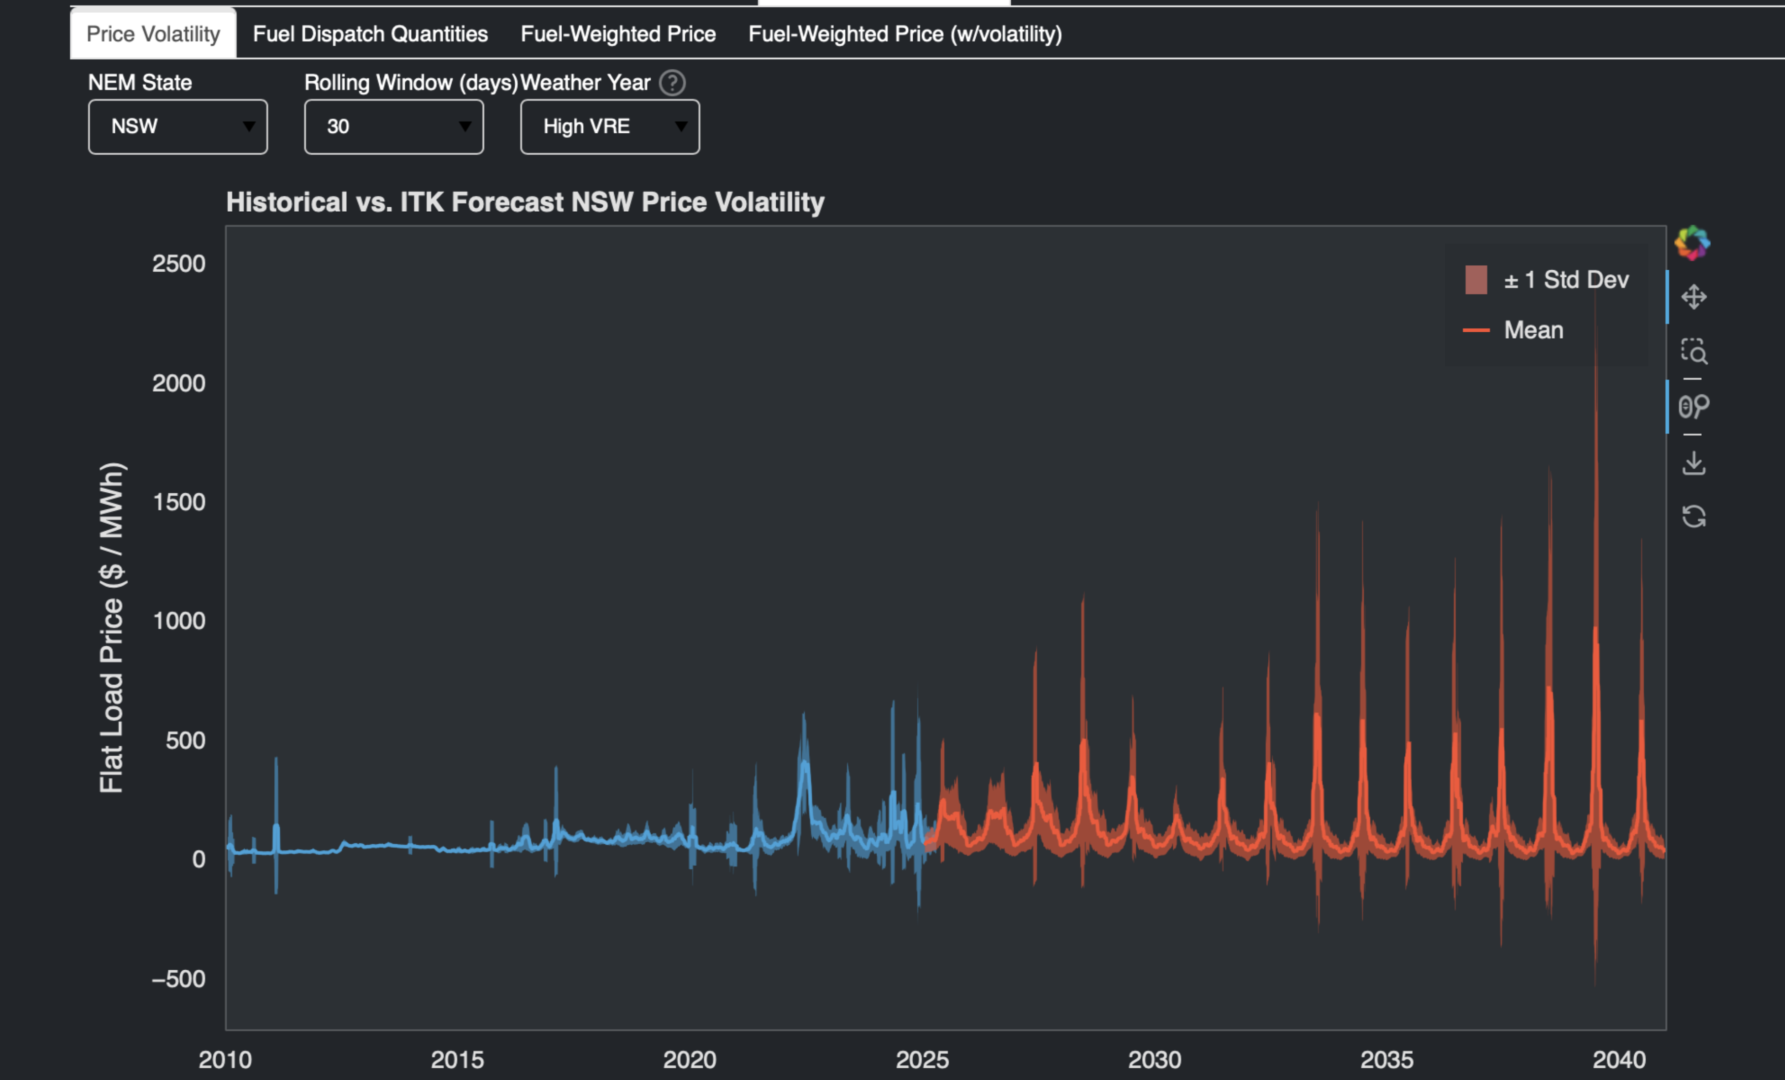
image-20250724211146557

Slide 5
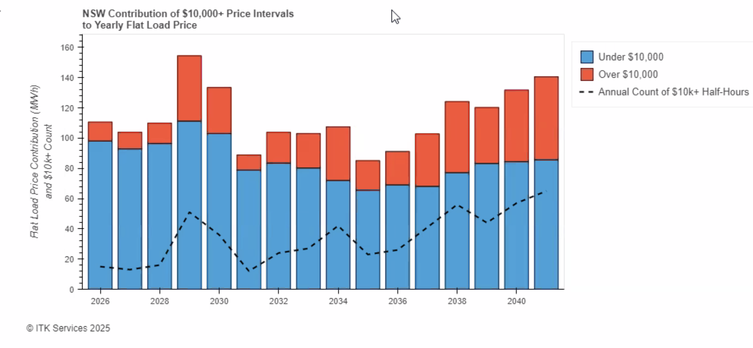

Slide 6
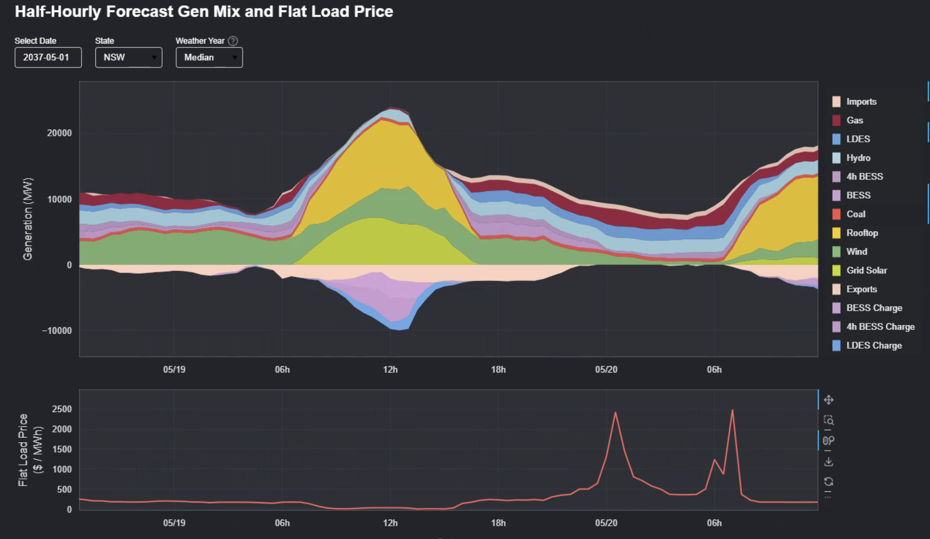
Notes:
Prices rise initially in low wind and solar conditions as 2 hour batteries run out, 4 hour batteries keep going.
Prices fall through the night as demand falls but the wind also continues to fall.
When demand picks up in the morning prices rise but not to dramatic levels wind is nearly zero.

Slide 7
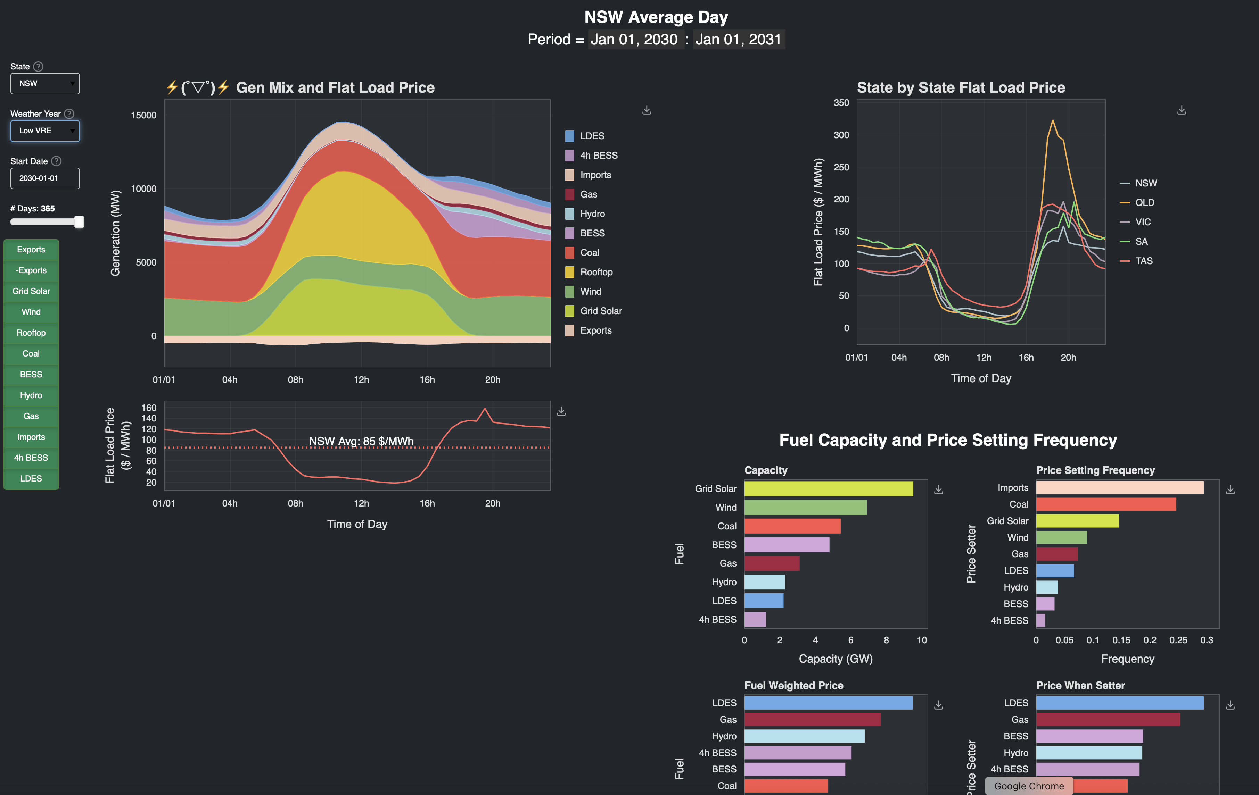
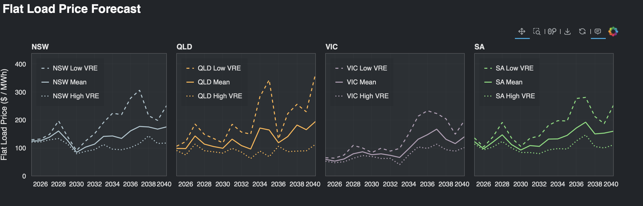
#
image-20250725081235830
image-20250725081408123

